Slide 1

PEOPLE OF ACTION CAMPAIGNNES ERTAS
ARPIC Zone 20B 2018-2019
1 March 2019

Slide 2
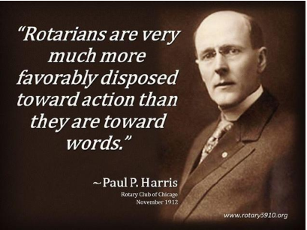
WE ARE PEOPLE OF ACTION

Slide 3
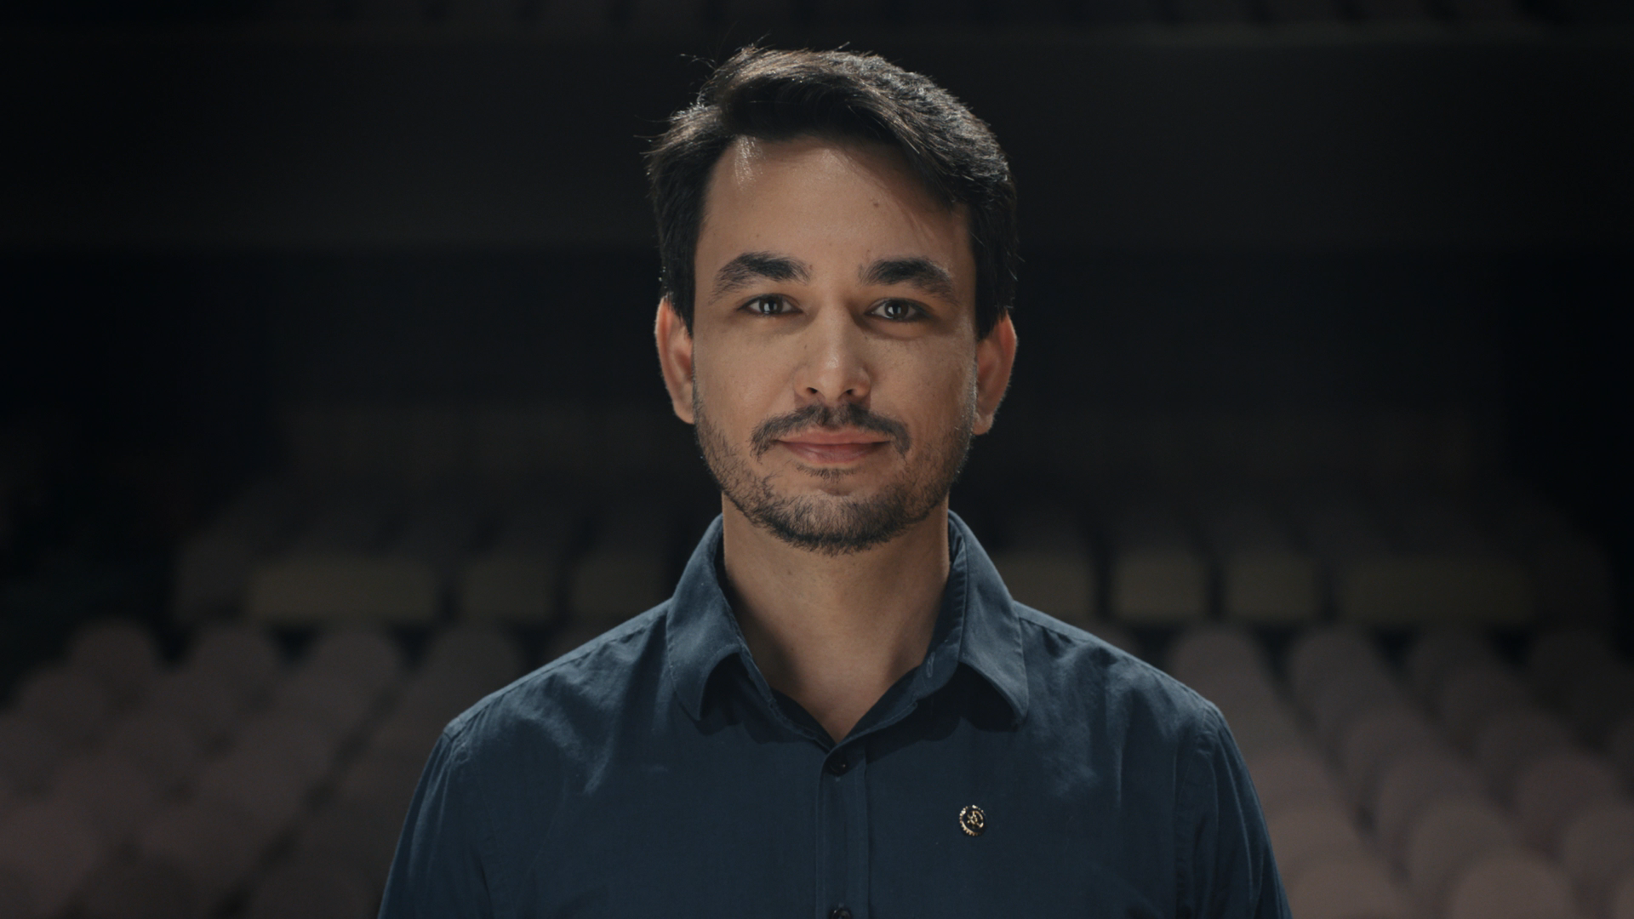

WE ARE PEOPLE OF ACTION
Slide 8

Slide 4

INTRODUCTION
People of Action campaign is a new global public image ad campaign of the Rotary International
It was launched at the Rotary International Assembly in January 2017
Rotary unveiled the campaign, at the Rotary International Convention in June in Atlanta, Georgia, USA
Slide 8

Slide 5

PEOPLE OF ACTION CAMPAIGN
People of Action campaign is:
  To tell Rotary’s story in a consistent and compelling way to the general public
  To make public understand the impact Rotary is making around the world
The campaign aims:
  To heighten the growing awareness of Rotary
  To deepen the public’s understanding of what Rotary is, what works the Rotarians do, and the impact they create in communities across the globe.
Slide 8

Slide 6
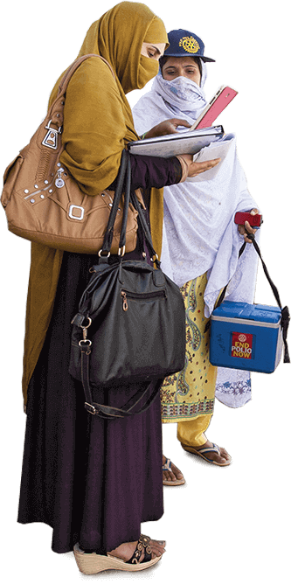
WHY WE NEED THE CAMPAIGN NOW ?
Despite more than a century of Rotarians philanthropic works all over the world, 35% of the public don’t know what is Rotary
They don’t know how Rotary International is making impact by improving communities
To thrive in the 2nd Century of SERVICE ABOVE SELF, Rotary needs a strong identity to promote itself to bring in new members.
1.2 million membership is almost the same as 10 years ago, though the clubs has increased.
Slide 8

Slide 7
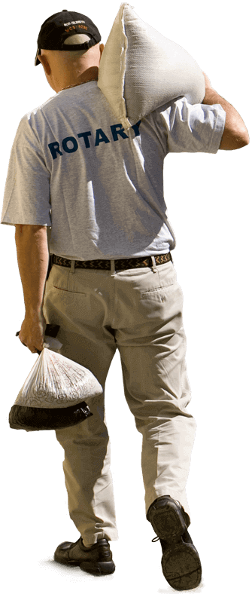
WHY IS THE CAMPAIGN’S THEME “PEOPLE OF ACTION”?
Because Rotarians share a unique passion for taking action to improve their communities
Where others see problems, Rotarians see solutions and possibilities
Create opportunity to show others how Rotarians see what’s possible in their communities
Highlight what Rotarians can achieve when more community leaders join Rotary
Slide 8

Slide 8


WHO ARE WE TRYING TO REACH ?
People who do not know about Rotary or how they can benefit from Rotary programs
Potential members who want to make a difference in their communities
People interested in Rotary’s causes
People looking to establish relationship with others in their communities
Slide 8

Slide 9
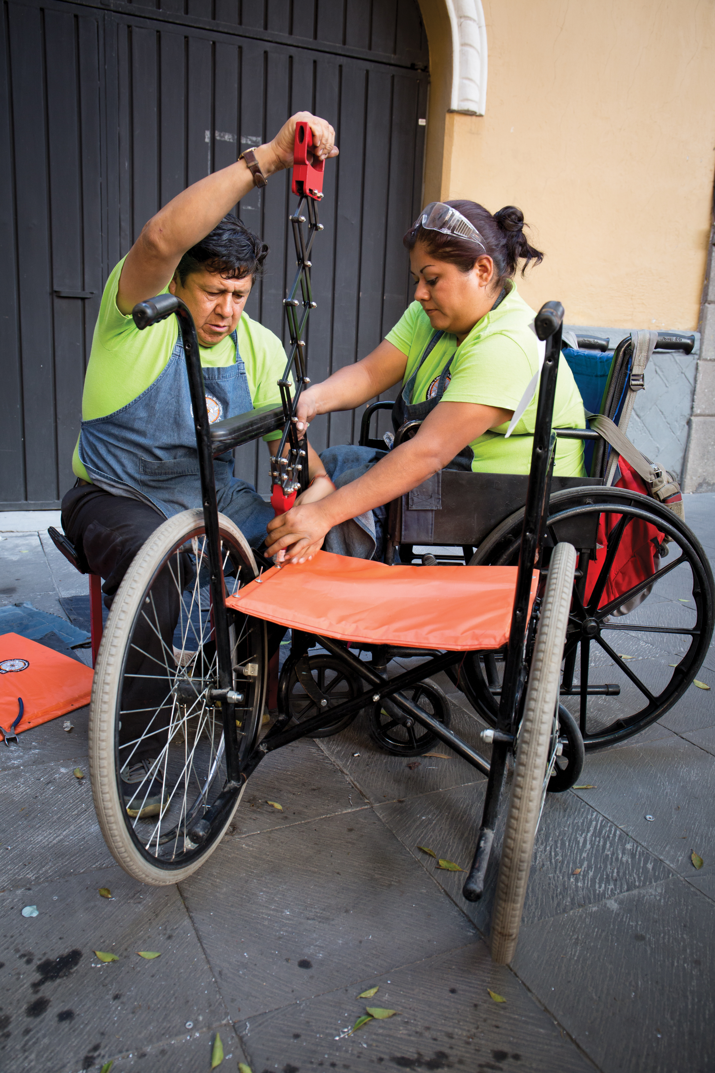
WHAT ARE OUR CAMPAIGN OBJECTIVES?
To narrow gap between awareness and understanding
To define ‘What is Rotary?’ and the impact it makes
To lay foundation for member engagement, cause, donation and other activities
To allow Rotary clubs to localize ads for relevance and simple understandings.
Slide 8

Slide 10
WHAT ARE OUR CAMPAIGN STRATEGY?
Highlight Rotarians as People of Action
Extensive and effective use of campaign material
Share vision and ideas with fellow members and community partners and experts to exchange ideas about potential and lasting solutions
Mobilize others to take action to bring those ideas into life
Slide 8

Slide 11
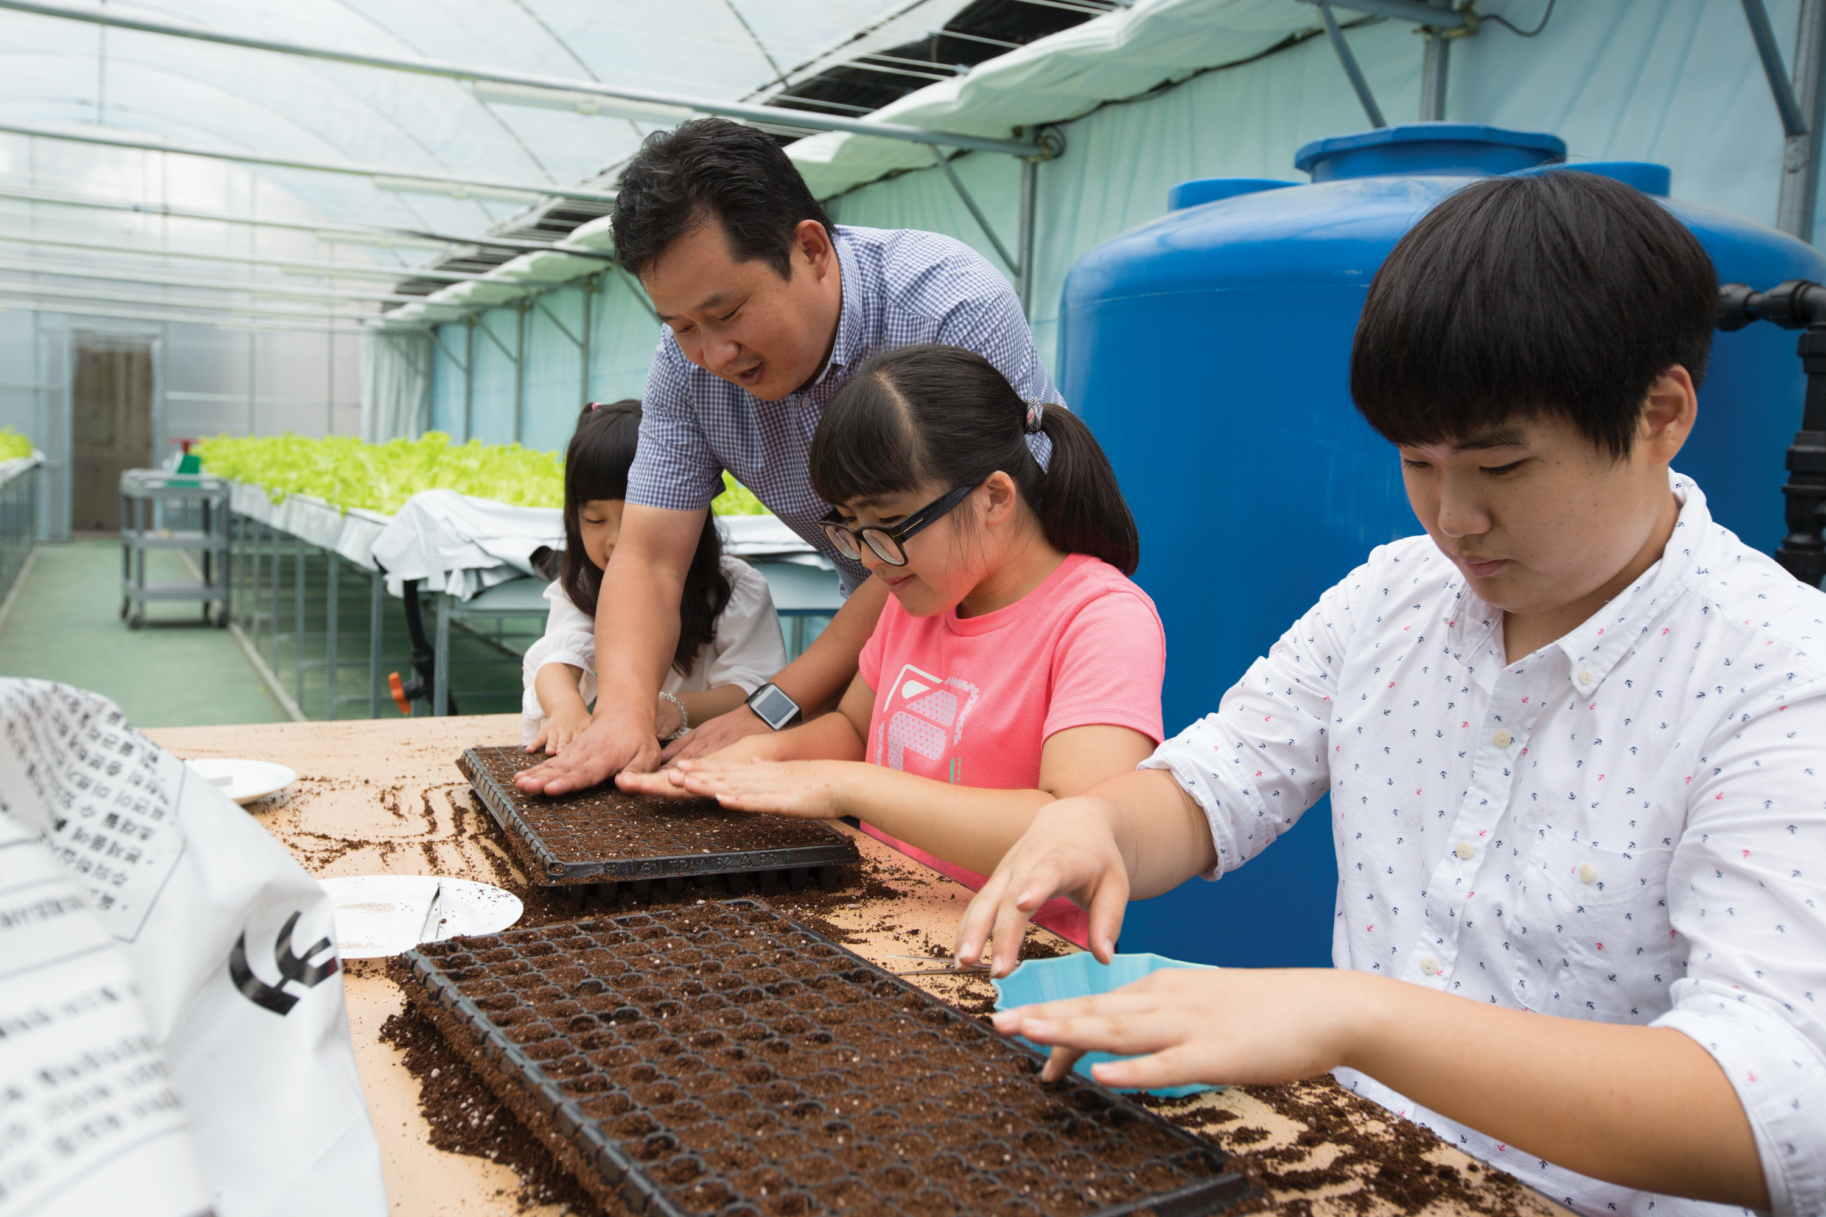
WHAT CAMPAIGN MATERIALS ARE ABAILABLE ?
Videos
Social media graphics
Advertisements for print and digital media
Radio / TV spots
Brochures
Campaign guidelines
Advertisement assets are available in all Rotary languages
Slide 8

Slide 12
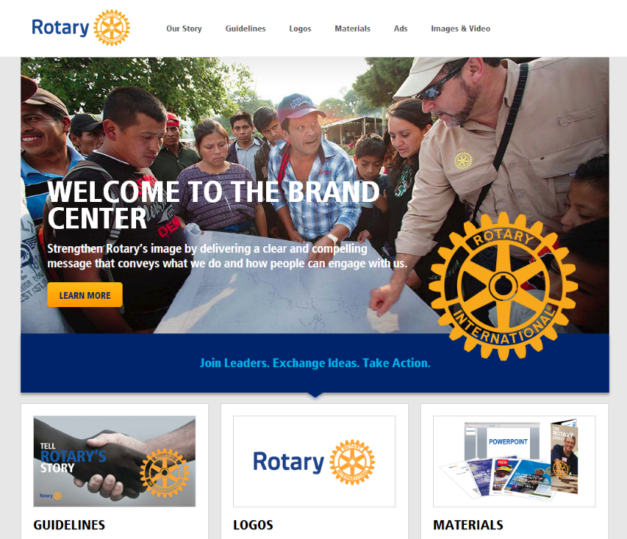
THE BRAND CENTER
RI portal with abundant resources
Slide 8

Slide 13
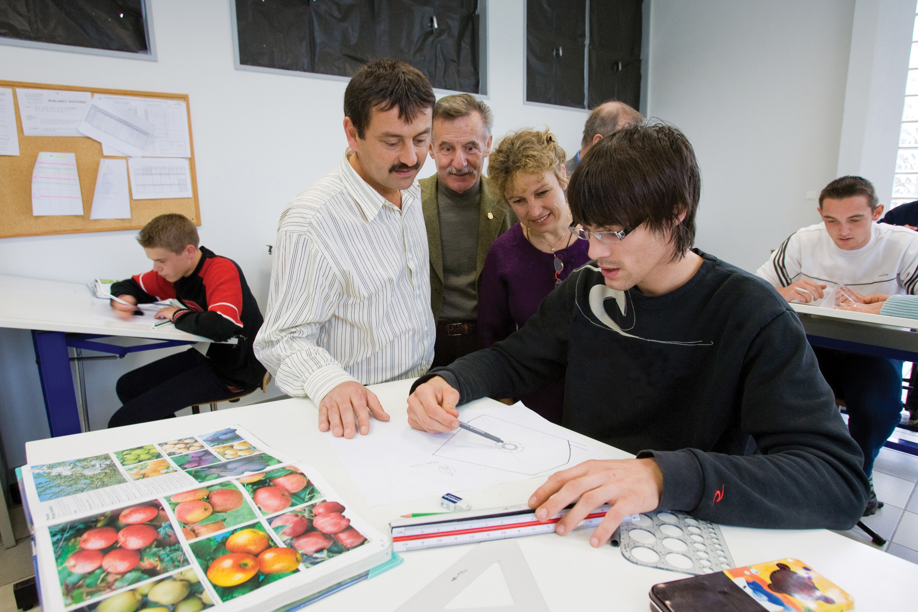
HOW YOU CAN HELP ?
Go to www.rotary.org/brandcenter. Download the People of Action campaign materials
2. Share materials with club members. Particularly with advertising professionals who can help place ads in local community magazines and newspaper.
3. Collaborate with your District Leaders. Work with your district public image coordinator for additional guidance
Slide 8

Slide 14

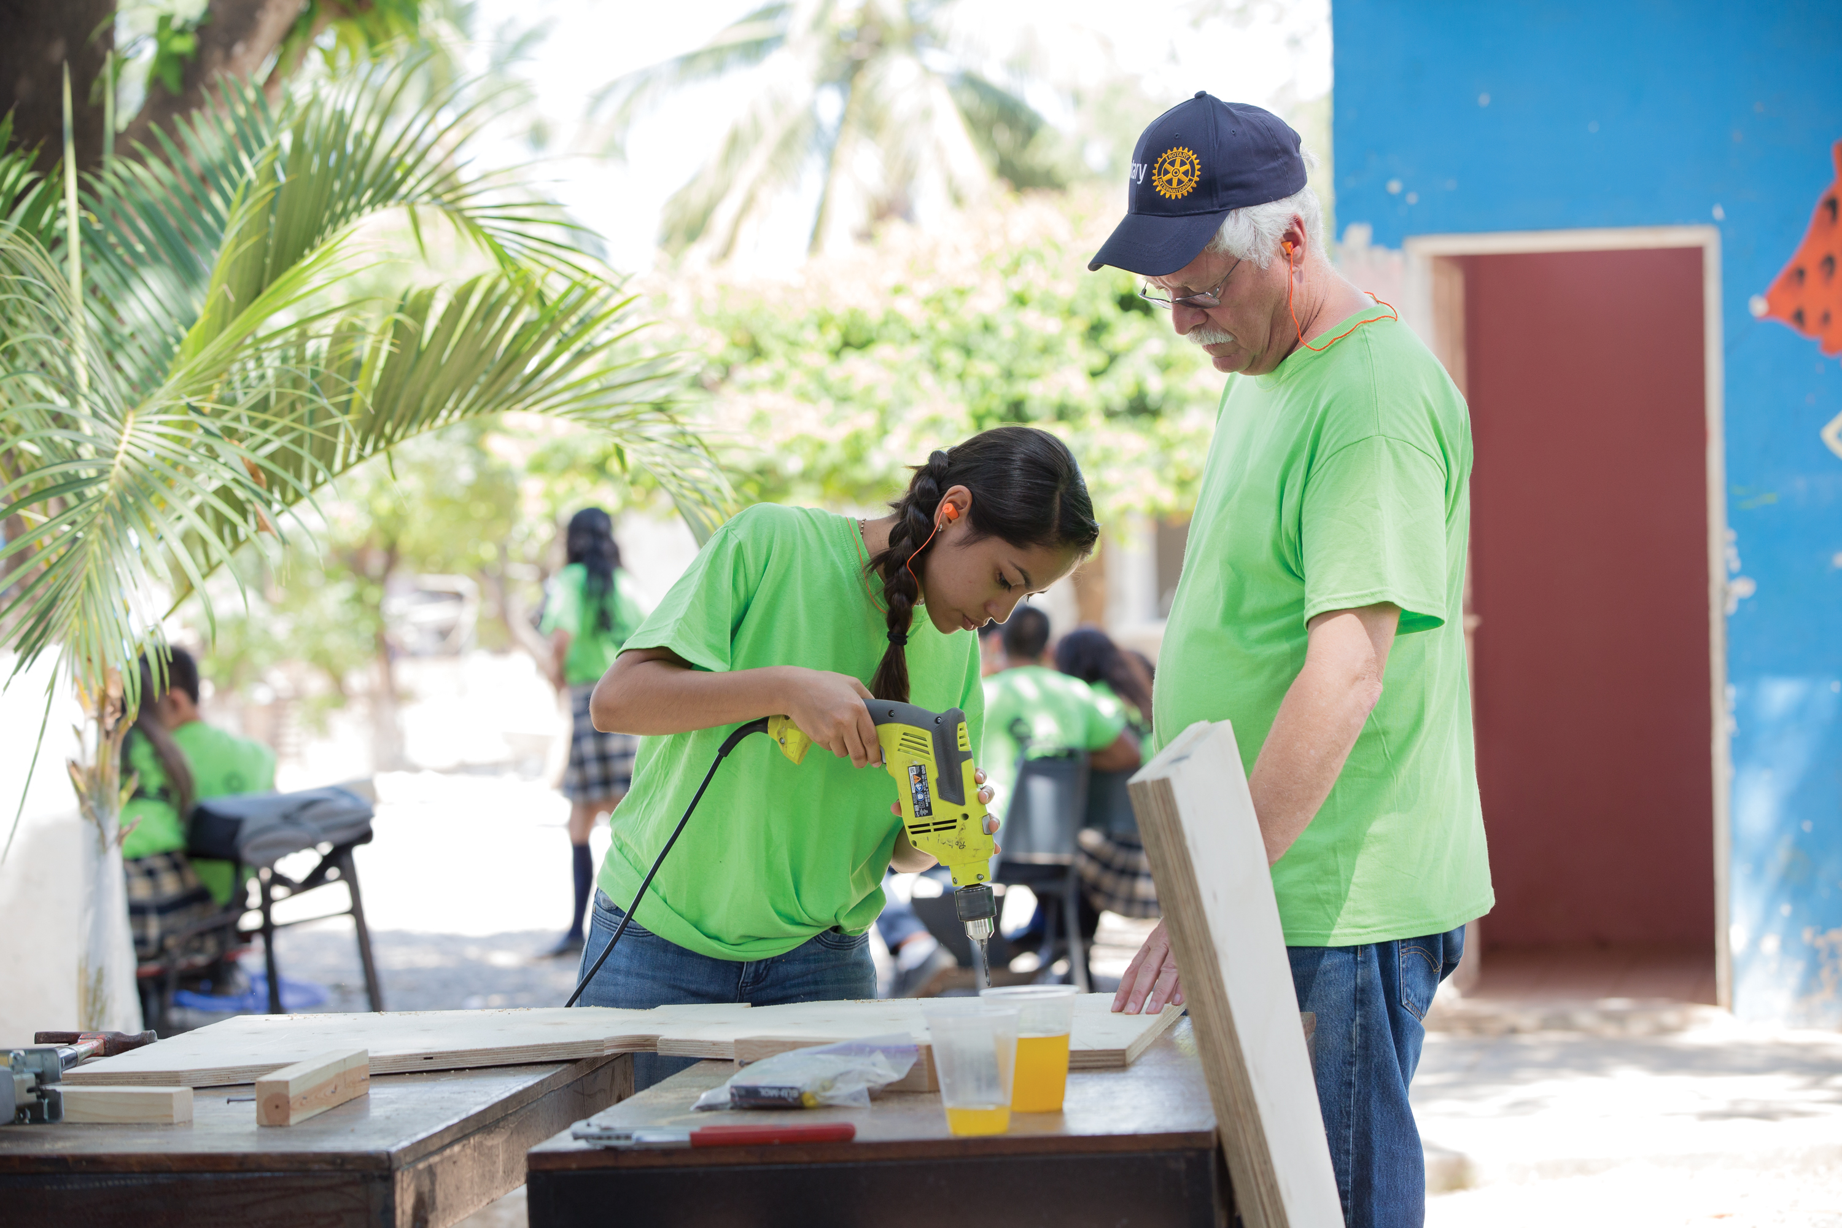
HOW YOU CAN HELP ?
4. Use social media. Share campaign videos and graphics on your Facebook and Twitter accounts and inspire your community
5. Tell your success stories. E-mail to pr@rotary.org Rotary’s marketing team with your success stories and questions
6. Consider adding campaign graphics to:
- District / Club websites
- Post them on social media
- Display the ads at events
Slide 8

Slide 15
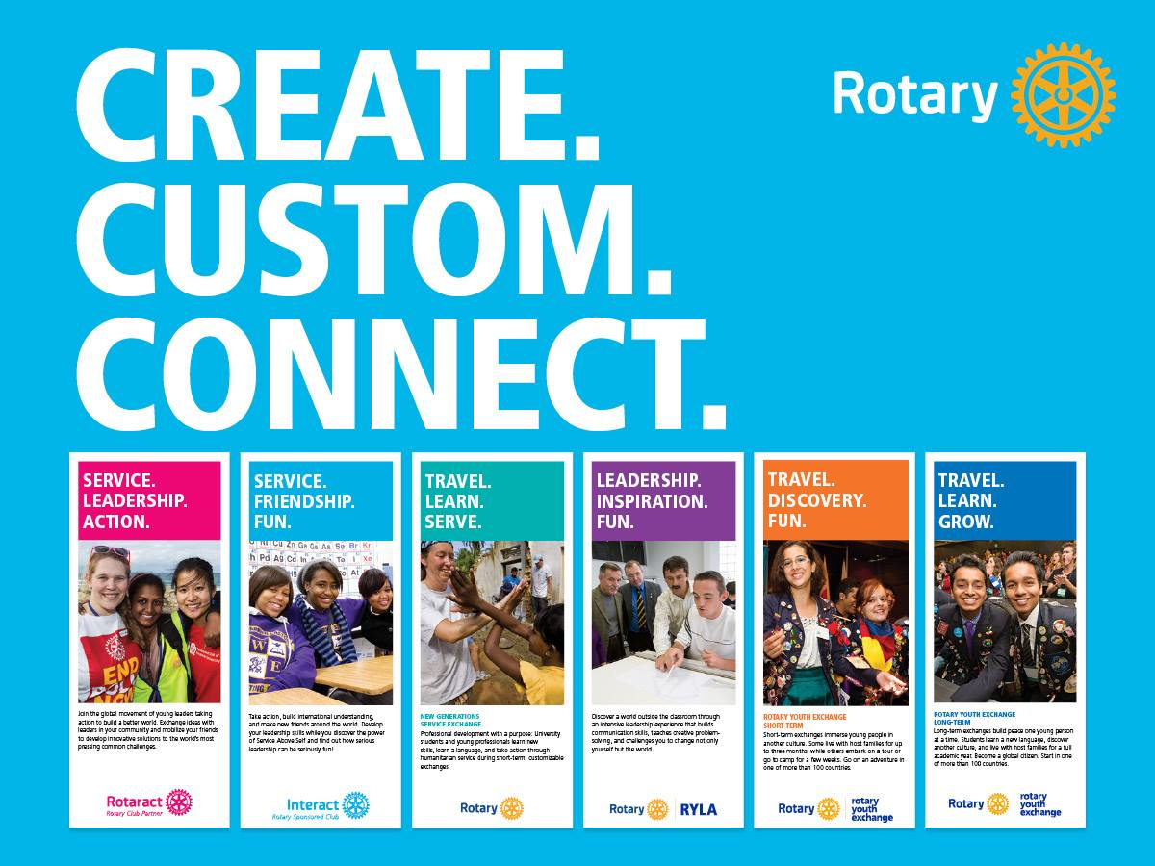
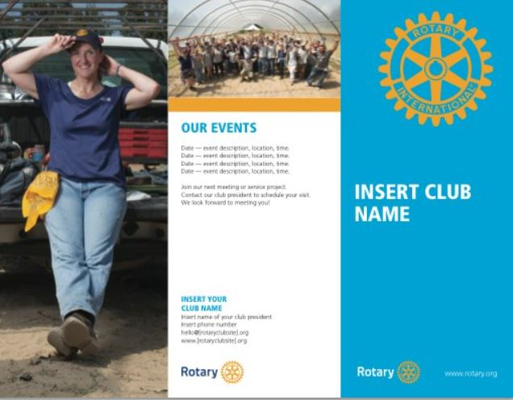
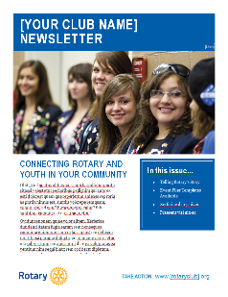
HOW THE CLUB CAN USE THE CAMPAIGN MATERIALS?
Download the guidelines
Follow guidelines to develop media plans
Create your own club logo
Use templates as a starting point
Use images to inspire your
own club brochures
Modify campaign materials with
pictures of your own projects
Slide 8

Slide 16

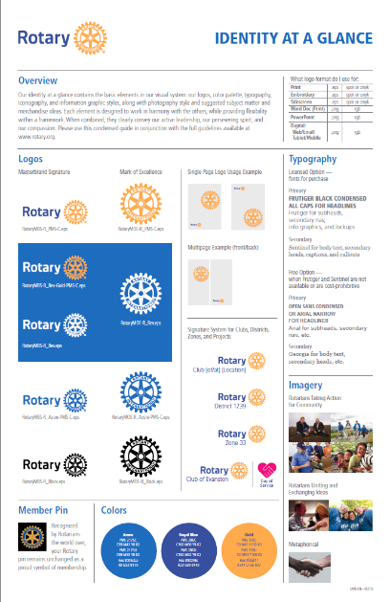
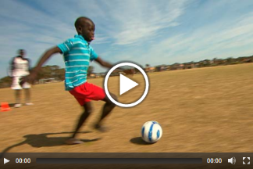

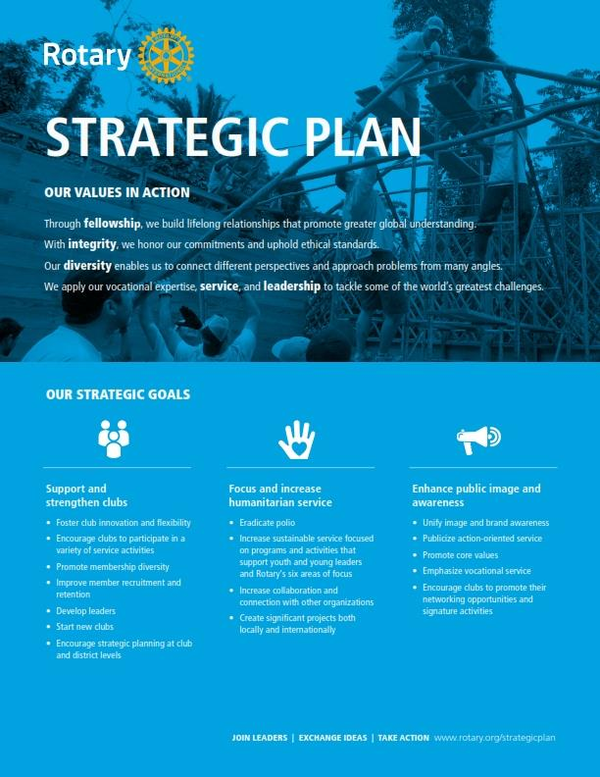

OTHER EXISTING PUBLIC IMAGE RESOURCES FOR CLUBS?
Visual & Voice Identity Guide
Logos
Prospective member brochure
Club brochure template
Event planning guide
Banners for events
Be a Vibrant Club Publication
Rotary Channels: Website, social media,
Rotarian Magazine
Messaging guide
Social Media and PR guides
www.rotary.org/brandcenter
Slide 8

Slide 17
HOW DOES THE CAMPAIGN WORK ?
People of Action campaign:
Bring the Rotary brand to life by highlighting what happens when community leaders within Rotary join hands together
Share the vision of existing Rotary brand
Exchange ideas about solutions
Take action to make the vision a reality
Slide 8

Slide 18




WE ARE PEOPLE OF ACTION
Together we INSPIRE
Together we CONNECT
Together we
END
POLIO
Together we TRANSFORM
Slide 13

Slide 19
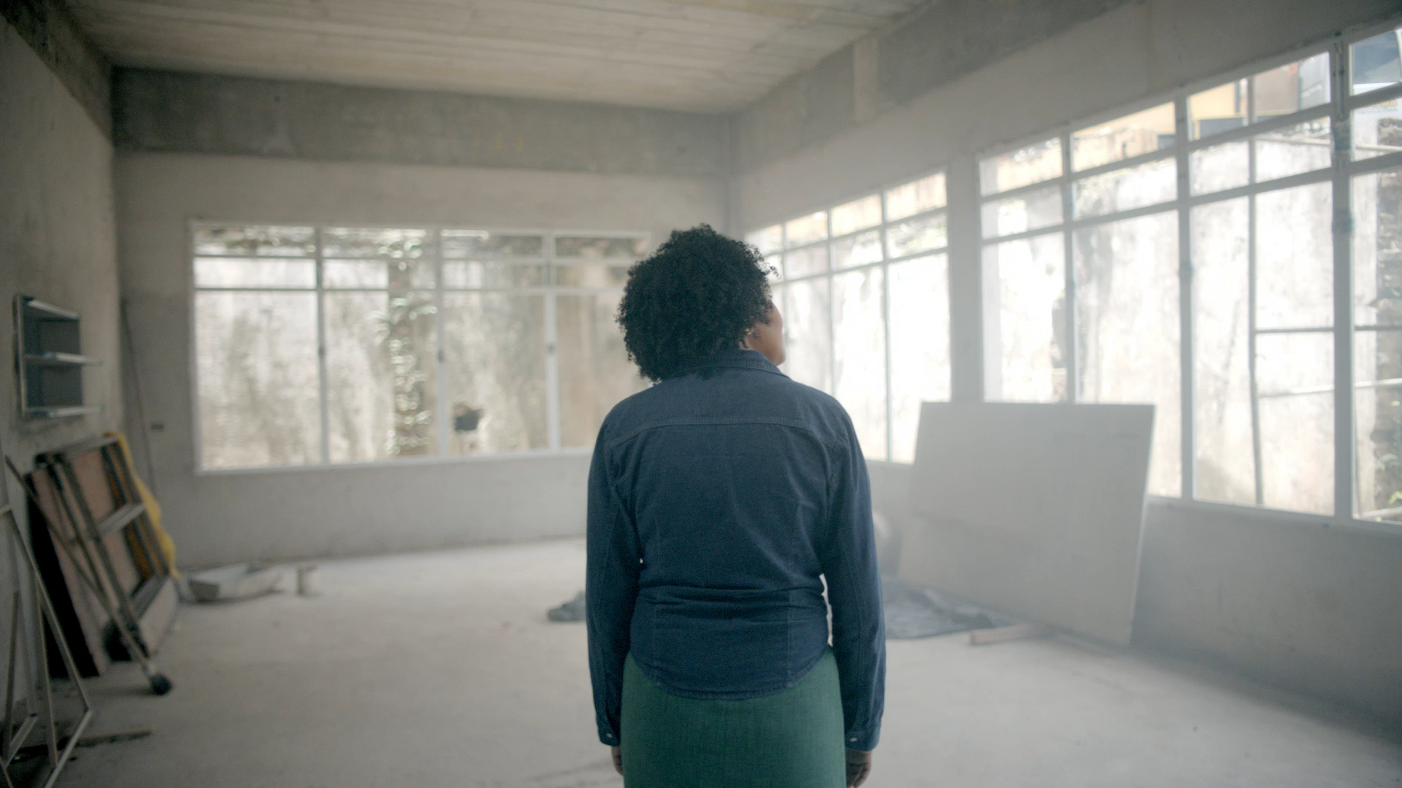
WE ARE PEOPLE OF ACTION

Slide 20
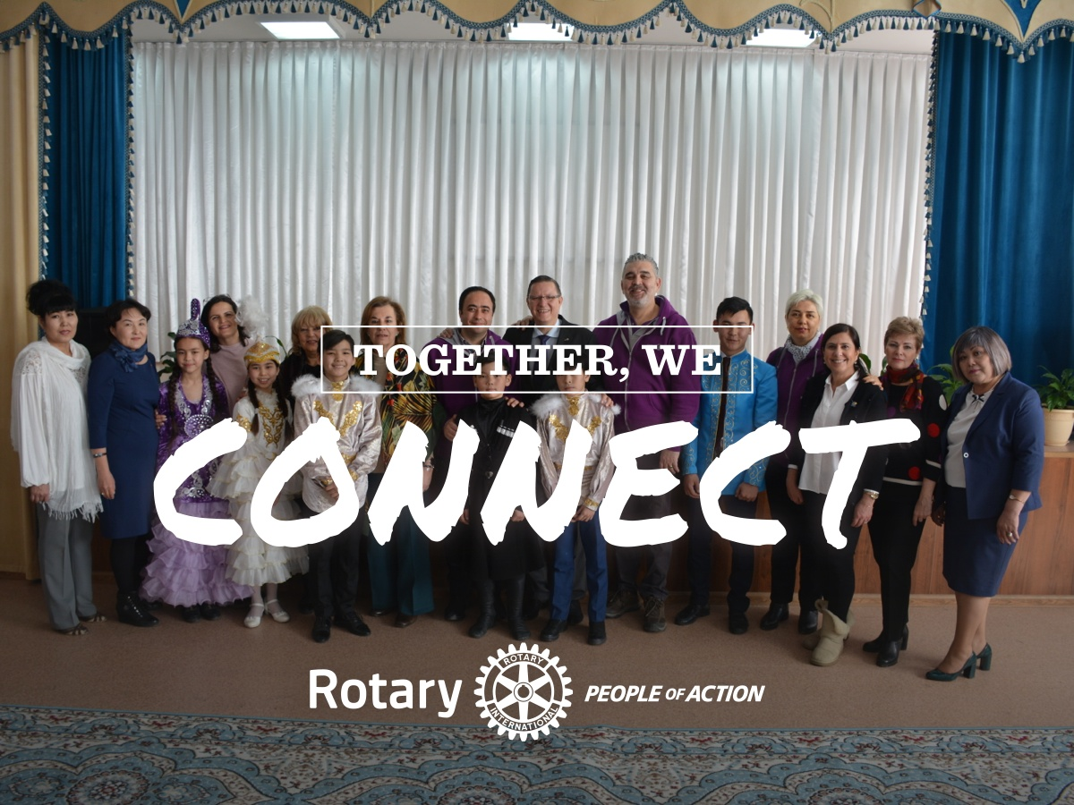
WE ARE PEOPLE OF ACTION

Slide 21
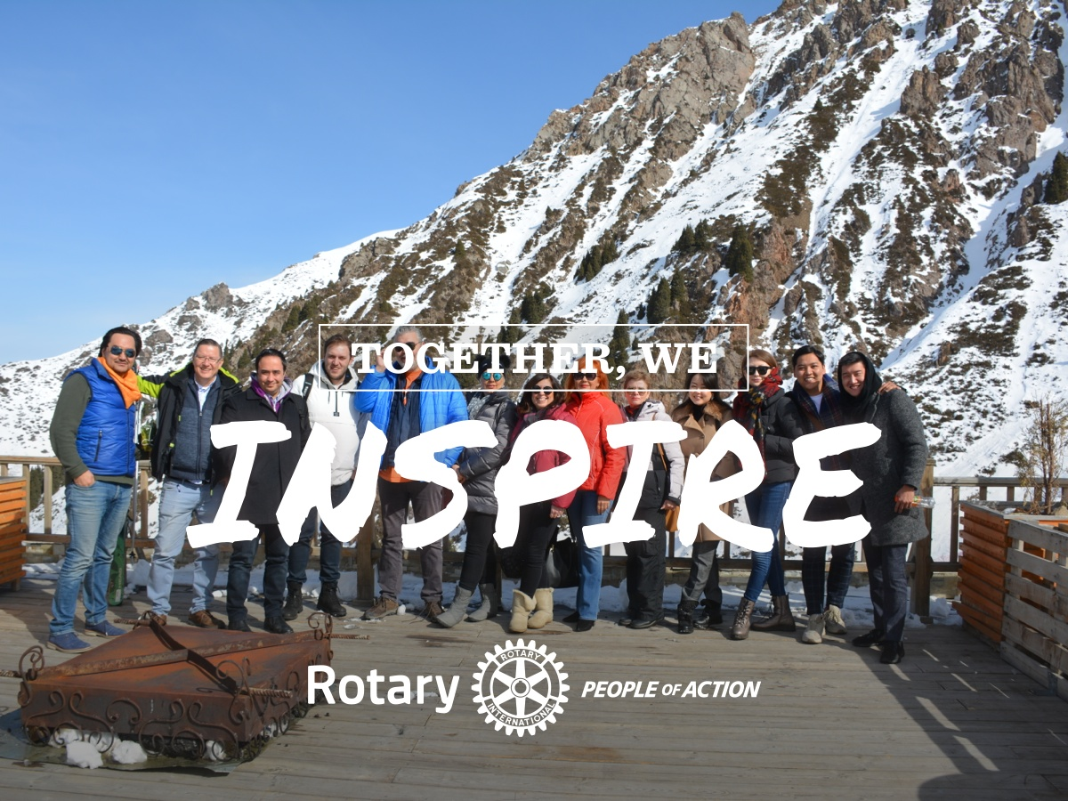
WE ARE PEOPLE OF ACTION

Slide 22

WE ARE PEOPLE OF ACTION
Together, we are Rotary
&
We are People of Action
May God Bless Us All.

